Slide 1
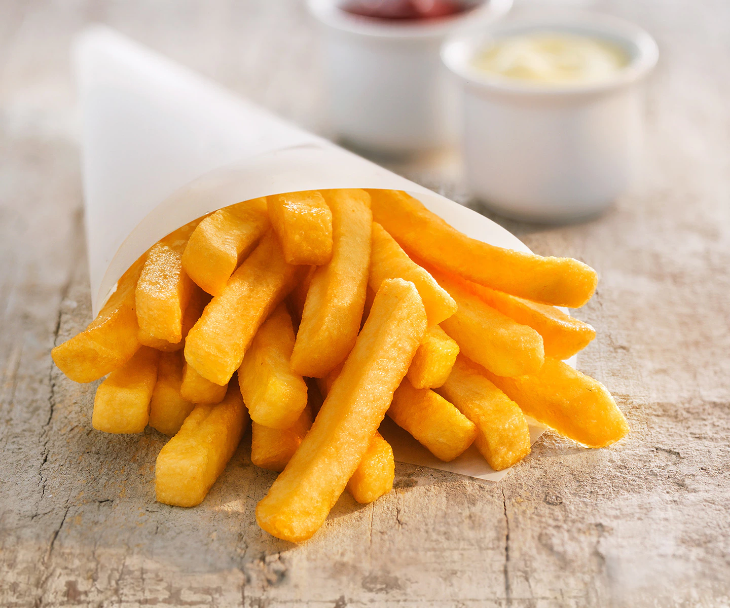


abc
pimmel

Slide 2
Pommes jungeeeeeeeeeeeeeeeeeeeeee

